Slide 1
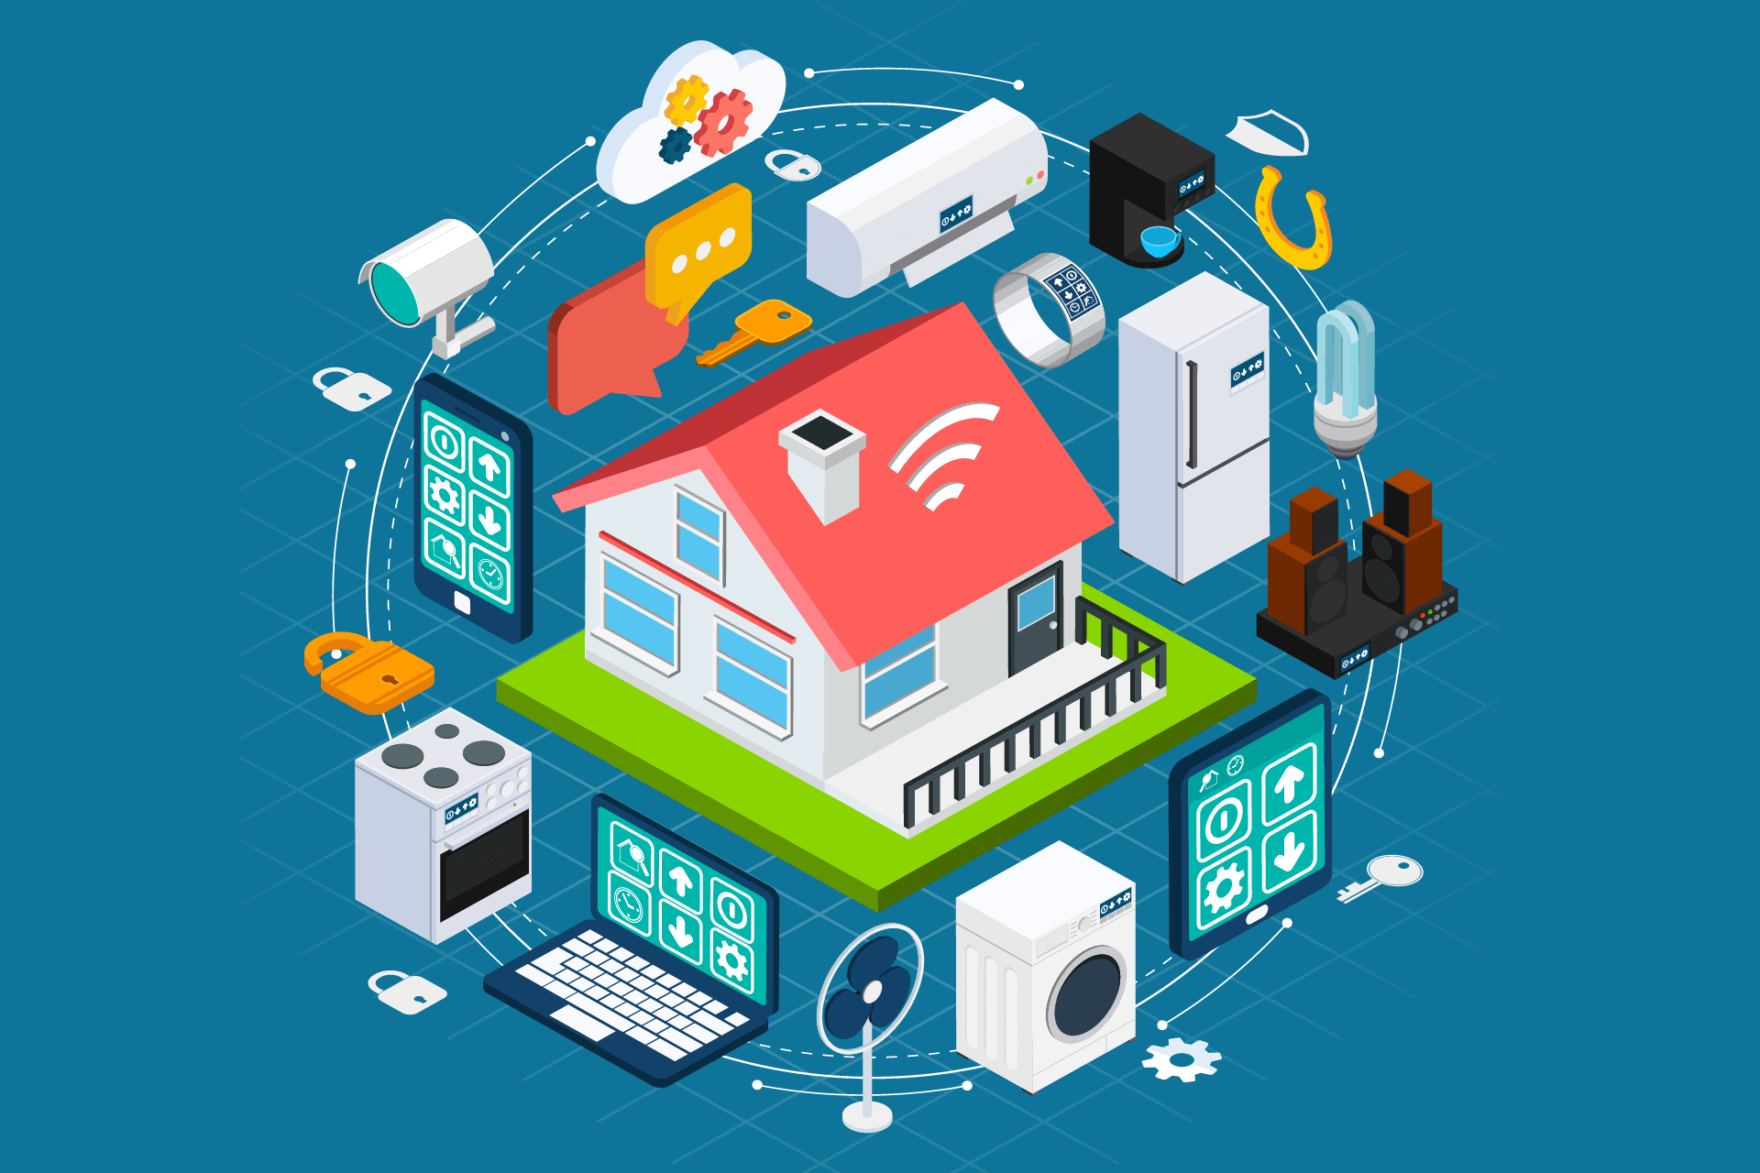
IOT BASED SMART DOOR LOCK
BY MECIA HACKERS

Slide 2
COMPONENTS USED IN THIS PROJECT
NODE MCU
Ultrasonic Sensor
SOLENOID LOCK
5V RELAY
DC- DC step down Buck converter
CAMERA MODULE
12v battery

Slide 3
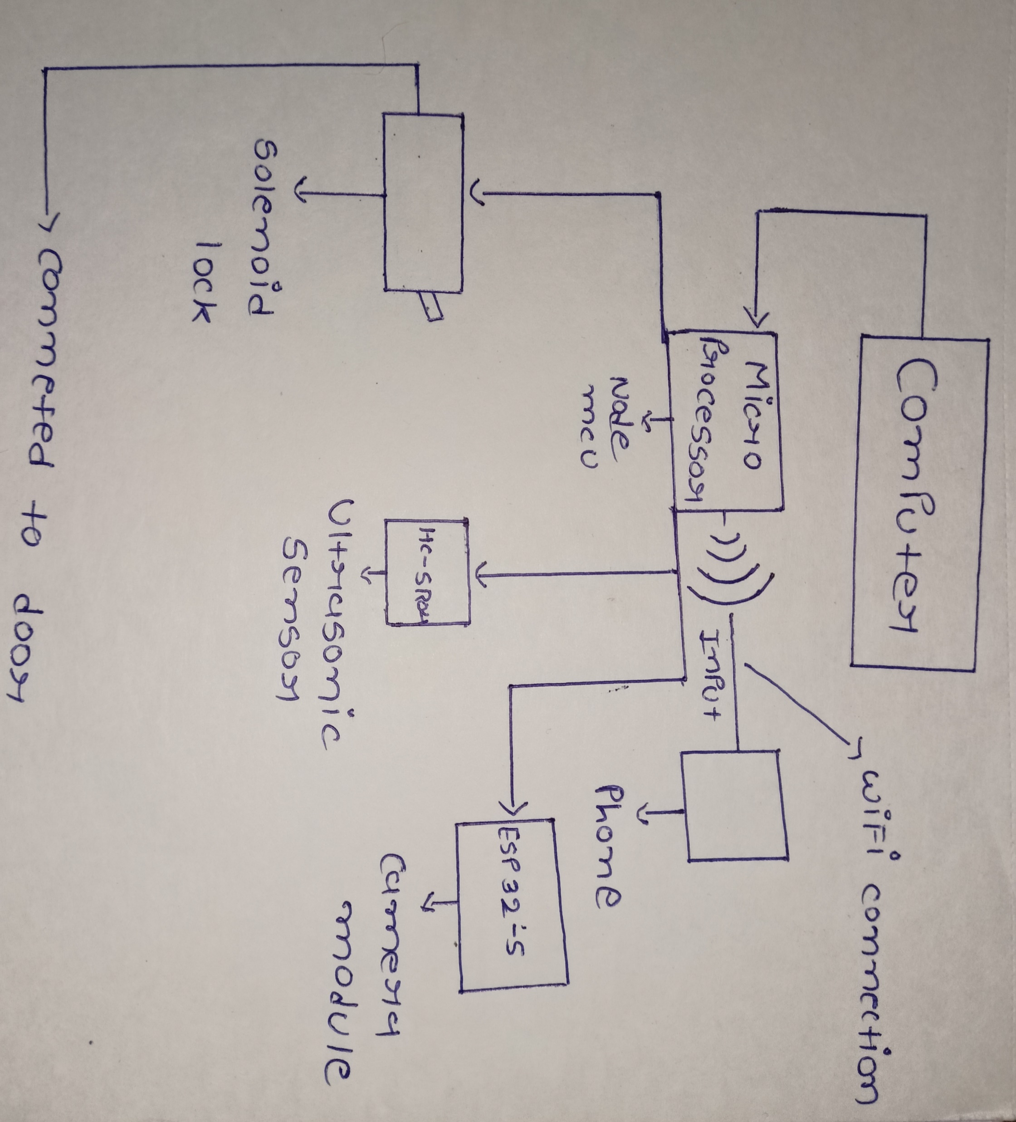
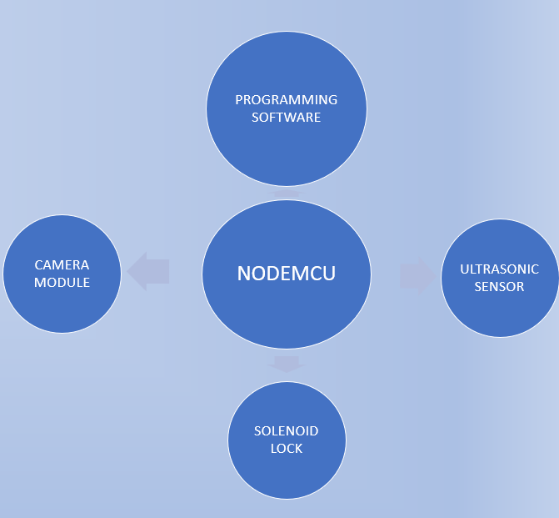
BLOCK DIAGRAM

Slide 4
BASIC IDEA OF WHAT WE ARE GOING TO DO!
Firstly we are using NODE MCU which is a type of Arduino with inbuild wi-fi module
Then we are going to configure NODE MCU with Arduino IDE software.
Next we are going to connect sensors and controllers to the Arduino such as ultrasonic sensor and camera module to it.
And we are going to code for it in the same software.
Then we are going to connect it with a website where all the data is going to be stored!

Slide 5
ADVANTAGES
Using a smart door lock system has many of its own advantages:
It's secure.
simple and easy to access.
It's pick-proof.
Entire lock and electronics housing is well constructed.
We can use multiple smart locks.
App is also viewing who is passing through the door by the camera and sending stream directly to the device.

Slide 6
APPLICATIONS
Control of doors and windows shutters.
Faster operation and efficient.
Security system.
This project can be used in Industries, Home, Office, Shops.
Can be used for garage doors and gates.
By using smart app,disabled or elderly people can control lock as well as appliances anywhere inside house.

Slide 7
FUTURE ENHANCEMENTS
In future there can be a smart phone application enhancement for this project that is, creating a smart phone app to give access to guests when person is away from his/her home.
This can also extends to, if someone is trying to break in the door, alarm will start beeping on mobile device as well.

Slide 8
CONCLUSION
In this project, smart door lock system based on wi-fi which integrates the home security with home automation.
Home security system for automatic doors provides advance security of today's standard for home owners.
Since our proposed system is built over wireless sensor network, it is a cheap, flexible, and easily installable system without any overhead such as careful planning, cabling, and construction works

Slide 9


